Slide 1

INFRASTRUCTURE SOLUTIONS OF CLOUD
Module Number: 03
Module Name: Azure Storage

Slide 2
Syllabus:
Azure Storage
Storage account in azure
Implement blobs and azure files
Types of storage in azure
Blob
Table
Queue
Drives

Slide 3
Syllabus:
Azure Storage
Managing storage account keys
Implementing SQL databases
Choosing a service tier
Implementing point-in-time recovery
Implementing geo-replication
Scalability strategies
Importing and exporting data

Slide 4
Azure Storage
Aim:
To equip the students to Manage Azure Storage for various application

Slide 5
Azure Storage
Objectives:
The Objectives of this module are:
Differentiate the various Azure Storage
Deploy SQL Database on Azure Platform.
Modify a Blob Storage and Tables in azure
Implement a Scalability strategies

Slide 6
Azure Storage
Outcomes:
At the end of this module, you are expected to:
Compare the various Azure Storage types
Design Storage for different application on azure Platform
Implement Importing and exporting data on SQL Database
Create Scalability strategies in Storage on Azure Platform.

Slide 7
Table of Contents
Azure Storage
Storage account in azure
Types of storage in azure
Blob
Table
Queue
Drives
Implement blobs and azure files

Slide 8
Table of Contents
Azure Storage
Managing storage account keys
Implementing SQL databases
Choosing a service tier
Implementing point-in-time recovery
Implementing geo-replication
Scalability strategies
Importing and exporting data

Slide 9
Azure Storage
Storage account in azure
All of our Azure Storage data objects, including as blobs, file shares, queues, tables, and discs, are stored in an Azure storage account.
Our Azure Storage data is available from anywhere in the globe over HTTP or HTTPS because to the storage account's distinctive namespace, which it offers.
Our storage account's data is enduring and highly available, safe, and incredibly scalable.

Slide 10
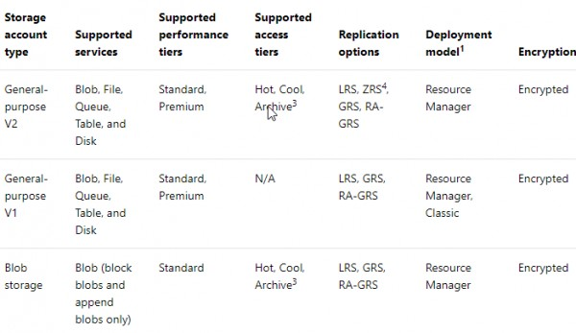
Azure Storage
Storage account in azure
Source: https://www.edureka.co/community/40011/different-storage-accounts-there-major-difference-between

Slide 11
Azure Storage
Storage account in azure
Storage account endpoints our data is housed in a specific namespace in Azure thanks to a storage account. Our specific account name is part of the URL address for each object we store in Azure Storage. Our storage account's endpoints are created by combining the account name and the service endpoint.
For a storage account, two service endpoint categories are available: common endpoints (recommended). With basic endpoints, you can create up to 250 storage accounts per region inside a single subscription.
Endpoints for Azure DNS zones (preview). With Azure DNS zone endpoints, you can create up to 5000 storage accounts per region inside a single subscription.
We can create accounts with either in a single subscription.

Slide 12
Azure Storage
Types of storage in azure
Determining what you want to store, how, and which options and features you require to do that is one of the most crucial phases in choosing a Microsoft Azure storage type.
Microsoft Azure offers five storage options that are split into two categories.
The first group, which consists of Queue Storage, Table Storage, and Blob Storage, is accessible via REST API and was created with file storage, scalability, and communication in mind.
The other, which consists of File Storage and Disk Storage, is only accessible via Virtual Machines and is used to expand the functionality of the Microsoft Azure Virtual Machine environment. (Avoid getting sidetracked by the File Storage's name. It does not represent how files are stored in an unstructured manner.)

Slide 13
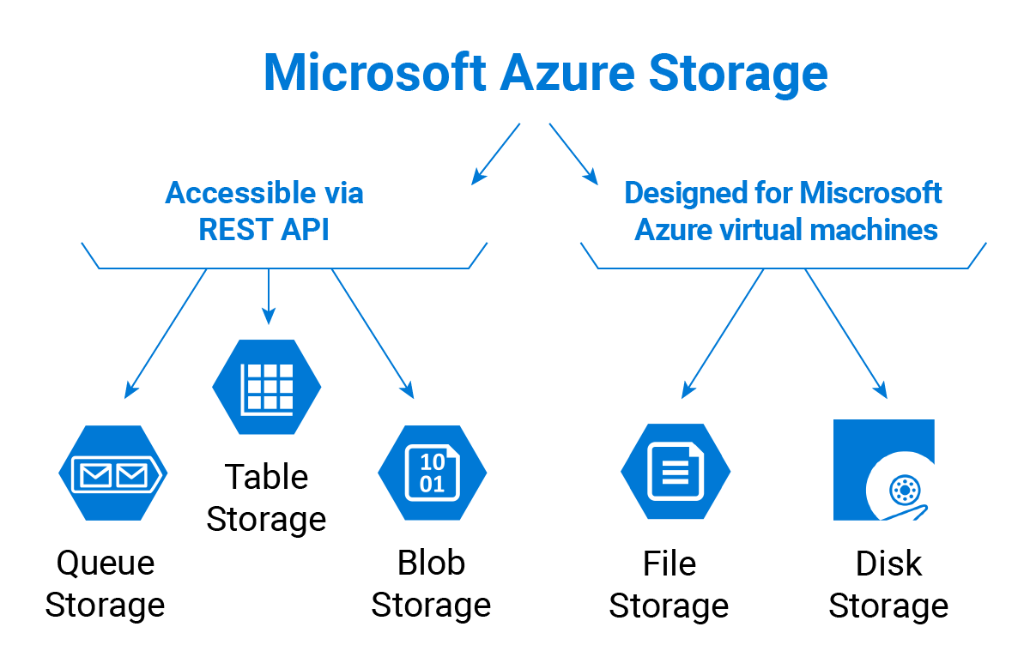
Azure Storage
Types of storage in azure
Source: https://www.msp360.com/resources/blog/microsoft-azure-storage-types-explained/

Slide 14
Azure Storage
Blob
Microsoft Azure's Blob Storage is where it all started. The abbreviation BLOB stands for Binary Large object.
Or, to put it plainly, the unstructured files, which include backup files, audio, video, and image files.
A file that is stored as a block blob arrives at the storage in bits and pieces (or, you guessed it, blocks), and is combined into a single file only after the upload is complete.
The file cannot be changed in this architecture without a full reload. This is the simplest and least expensive method of storing files in Azure.

Slide 15
Azure Storage
Blob
Append Blob
Suitable for keeping logs or meta-data, and is constantly updatable
You cannot change a Block Blob without re-uploading it, as we've already mentioned. However, there are circumstances where you must carry out several input/output processes, such as in databases.
Append Blobs were developed specifically for this reason; they are designed so that the user can upload portions of the files from the end.

Slide 16
Azure Storage
Blob
The foundation of the Microsoft Azure virtual machine system is Page Blobs. They were created expressly with disc space constraints in mind; each Page Blob should be larger than 512 bytes.
Data can be written to each component of a blob thanks to the architecture of Page Blobs.
Simple Page Blobs operate different sections of the device without a linear structure when a virtual machine or your on-premises system is using local storage (HDD or SSD with your disc partitions inside).
In reality, Page Blobs are used when running any kind of disc on a virtual machine in Microsoft Azure. That is not the end of the blobs, though. The so-called access tiers are also present.

Slide 17
Azure Storage
Blob
Access Tiers for Blobs
In addition to the three Blob kinds, Blob access tiers are available in Microsoft Azure. You may already be familiar with the terms "hot," "cool," and "cold storage tiers“.
The data that is regularly required is on the hot tier. It costs a lot to keep but is inexpensive to use.
The less frequently required data goes into the cool tier. Although accessing files costs more than storing them in the hot tie.
For your archives, use the chilly tier. Although accessing data there is quite expensive, storing them there is incredibly cheap.

Slide 18
Azure Storage
Table
What a surprise, you may store tables in the table storage. Not all tables, though. For the purpose of storing structured NoSQL data, Microsoft Azure Table Storage was created.
The storage is incredibly scalable while also being an inexpensive way to store data. However, if you access files frequently, the cost increases.
If you can do without the SQL structure and design and find Microsoft Azure SQL to be too pricey, this storage is handy.

Slide 19
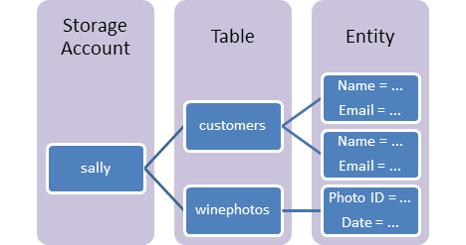
Azure Storage
Table
Source: https://learn.microsoft.com/en-us/azure/storage/tables/table-storage-overview

Slide 20
Azure Storage
Table
Azure Table Storage is a cloud-based service provided by Microsoft Azure that may be used to manage and store large amounts of structured NoSQL data (often known as "Big Data").
Table storage has a schema-less design and has a schema-less property to store data in keys or attributes.
This service has the ability to scale dynamically and adapt to the data as it evolves over time or as new applications are developed.
The Azure Table storage solution features reduced latency while reading and writing data from tables and is reasonably priced. It may store the same amount of data for a far lower price than standard relational or SQL database storage. additionally keep metadata from other sources, such as web apps, IoT devices, or other flexible datasets.

Slide 21
Azure Storage
Table
Large amounts of structured and non-relational data can be stored in NoSQL datastores using Azure Table Storage, and users can query this data to read and write tables.
As seen in the graphic below, Azure Table Storage provides a specific architecture for storing this data. Users can store one or more entities in a single table.
A Storage Account is where all of these entities are kept. Based on the storage account's capacity, a storage account may additionally contain one or more tables.

Slide 22
Azure Storage
Table
How to Use Table Storage in Azure?
Prerequisites:
Users with valid Azure credentials can use the Azure Table services using the Azure portal to create azure tables. It is the two steps process for the users first time user, the first user needs to create an Azure Storage Account and then Add a new table or move an application data to Azure Cosmos Db.

Slide 23
Azure Storage
Table
Each table on Azure Table Storage is made out of the following five elements: Entities: On relational databases, entities can be shown as rows (typical records).
Partition keys: Strings with a maximum size of 1 KB. They include one or more table entities, classifying them into blocks of entities with a common ID.
Row keys: Strings with a maximum size of 1 KB. They are utilised to uniquely identify rows within tables.
Properties known as timestamps keep track of when entities were added or changed.
Table partitions are groups of objects. Partitions are grouped together inside of one object like many tables using their partition keys as identification.

Slide 24
Azure Storage
Queue
Queue Storage is made to link the parts of your application together. It enables you to construct adaptable applications made up of separate, asynchronous message queuing-based components.
Let's assume you have an on-premises application communicating with a cloud server. You sometimes cannot send messages to the server because it is offline. You would typically make a mistake if you tried.
In this situation, you must also deal with the following asynchronous communication-related issues: the requirement for simultaneous availability of the transmitter and receiver. Of course, if one of them fails, communication breaks down.
Try/retry logic implementation is required to prepare for potential outages incorrect scalability.

Slide 25
Azure Storage
Queue
Azure supports two types of queue mechanisms:
Storage queues. Being part of the Azure storage infrastructure, they feature a simple REST-based GET/PUT/PEEK interface with reliable and persistent messaging within and between services.
Service Bus queues are part of a broader Azure messaging infrastructure that supports queuing as well as more advanced integration patterns.
Azure Queue storage is unquestionably a service for advanced users that requires certain know-how. We, therefore, suggest you to read Microsoft documentation to get a clearer picture of how it works in real life.

Slide 26
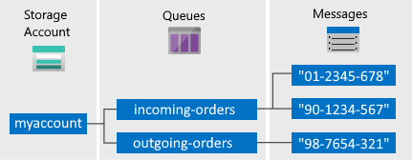
Azure Storage
Queue
Source: https://docs.microsoft.com/en-us/azure/storage/queues/storage-dotnet-how-to-use-queues?tabs=dotnet

Slide 27
Azure Storage
Queue
Storage Account: A storage account is required for any Azure Storage access. See Storage account overview for further details regarding storage accounts.
A queue is a collection of messages. There must be a queue for all messages. Keep in mind that the queue name must only be lowercase. Refer to Naming Queues and Metadata for details on naming queues.
Message: A message of up to 64 KB in any format. A message can stay in the queue for a total of seven days. The maximum time-to-live for versions 2017-07-29 and later can be any positive value, or -1 to indicate that the message never expires. The time-to-live is set to seven days if this argument is missing.

Slide 28
Azure Storage
Drives
Block-level storage volumes known as Azure managed discs are controlled by Azure and utilized with Azure Virtual Machines.
Managed discs are virtualized versions of real drives found in on-premises servers. All you need to do when using managed discs is define the disc type, size, and provisioning. Azure takes care of the remainder after you provide the disc.
Ultra discs, premium solid-state drives (SSD), standard SSDs, and normal hard disc drives are the many kinds of discs that are available (HDD).

Slide 29
Azure Storage
Drives
The advantages of managed disks
Let's go through a few advantages of using managed disks.
1. Highly durable and available
The availability of managed discs is 99.999 percent. This is accomplished by managed discs by giving you three copies of your data, enabling excellent durability.
The remaining copies help assure durability of your data and great tolerance against failures even if one or even two replicas encounter problems. With an industry-leading ZERO percent yearly failure rate, this architecture has enabled Azure to continuously guarantee enterprise-grade durability for infrastructure as a service (IaaS) discs.

Slide 30
Azure Storage
Drives
2. Integration with availability sets
To ensure that the discs of VMs in an availability set are sufficiently isolated from one another to prevent a single point of failure, managed discs are integrated with availability sets.
Disks are automatically inserted into various scale storage devices (stamps). Only the VM instances with discs on those stamps fail when a stamp fails due to hardware or software failure.
As an illustration, suppose you have an application operating on five virtual machines that are part of an availability set. The other instances of the programme continue to operate even if one stamp fails since the discs for those VMs are not all stored in the same stamp.

Slide 31
Azure Storage
Drives
3. Granular access control
To ensure that the discs of VMs in an availability set are sufficiently isolated from one another to prevent a single point of failure, managed discs are integrated with availability sets.
Disks are automatically inserted into various scale storage devices (stamps). Only the VM instances with discs on those stamps fail when a stamp fails due to hardware or software failure.
As an illustration, suppose you have an application operating on five virtual machines that are part of an availability set. The other instances of the programme continue to operate even if one stamp fails since the discs for those VMs are not all stored in the same stamp.

Slide 32
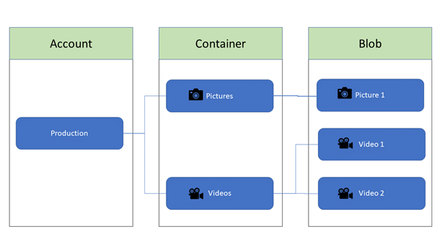
Azure Storage
Implement blobs and azure files
A blob container is similar to a directory in a file system which organizes the blobs.
A storage account can include an unlimited number of containers, and a container can store an unlimited number of blobs.
Source: https://www.serverless360.com/blog/azure-blob-storage-vs-file-storage

Slide 33
Azure Storage
Implement blobs and azure files
In the year 2015, Microsoft unveiled the Azure File Storage idea. Since Azure File Storage revealed the file sharing mechanism utilising the Server Message Block 3.0 (SMB) protocol, Microsoft Azure is able to offer us fully managed file shares in the cloud environment.
Any existing on-premises applications that require file sharing primarily use this protocol. As a result, moving our application from the on-premises environment to the cloud settings is a pretty simple process.
Azure File Storage supports the REST API standard, giving us the ability to create any contemporary application that has to be integrated with other programmes.

Slide 34
Azure Storage
Implement blobs and azure files
Azure File Storage is designed to support different types of business scenarios:
Migrating an existing application from the on-premises environment to the cloud. Azure File Storage provides us an option to migrate our on-premises file or file share-based applications to the Cloud environment without managing any highly-available file server VMs.
Customers can share server data across on-premises and cloud servers. Many applications now store data such as log files, event data, and backups in the cloud environment to achieve better availability, durability, scalability, and geo-redundancy.

Slide 35
Azure Storage
Implement blobs and azure files
3.We can integrate modern applications with the help of Azure File Storage.
4. We can simplify the hosting high availability (HA) workload data with the help of Azure File Storage. Since Azure File Storage provides continuous availability, it simplifies the effort to host HA workload data in the cloud

Slide 36
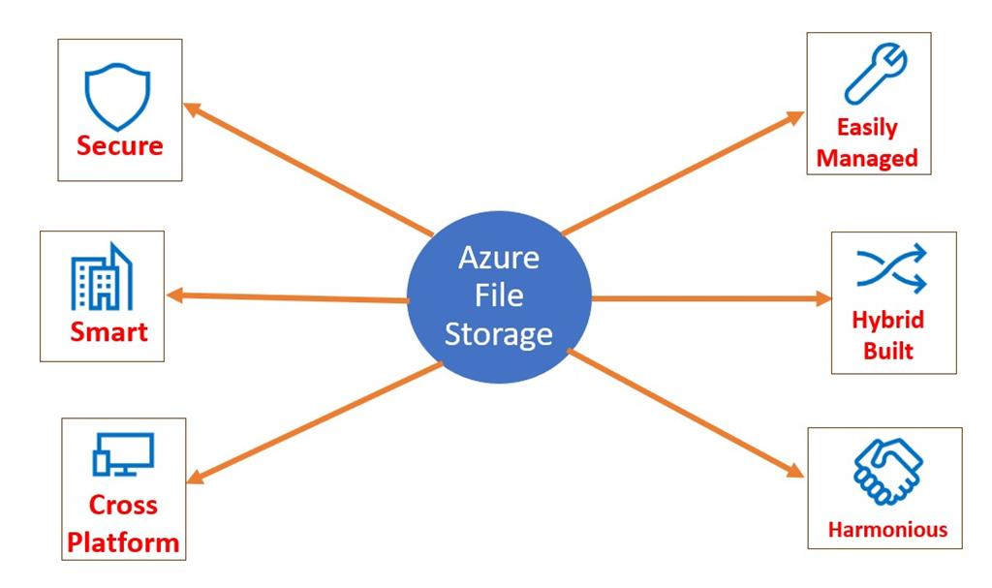
Azure Storage
Implement blobs and azure files
Source: https://www.c-sharpcorner.com/article/implement-azure-file-storage-using-asp-net-core-console-application/

Slide 37
Azure Storage
Managing storage account keys
The information in your storage account can be secured using your personal encryption key.
When a customer-managed key is specified, it is used to safeguard and regulate access to the key that encrypts your data. Access control management is more flexible with customer-managed keys.
Your customer-managed keys must be kept in one of the following Azure key stores:
Azure Key Vault
Azure Key Vault Managed Hardware Security Module (HSM)

Slide 38
Azure Storage
Managing storage account keys
Azure Key Vault
Azure Key Vault Managed Hardware Security Module (HSM)
You can either create your own keys and store them in the key vault or managed HSM, or you can use the Azure Key Vault APIs to generate keys.
The storage account and the key vault or managed HSM must be in the same Azure Active Directory

Slide 39
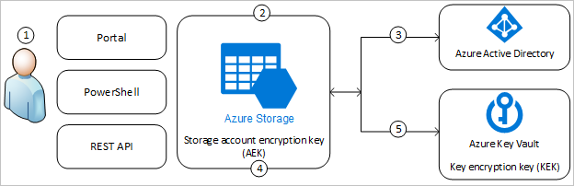
Azure Storage
Managing storage account keys
The following diagram shows how Azure Storage uses Azure AD and a key vault or managed HSM to make requests using the customer-managed key:
Source: https://docs.microsoft.com/en-us/azure/storage/common/customer-managed-keys-overview

Slide 40
Azure Storage
Managing storage account keys
An Azure Key Vault admin grants permissions to encryption keys to a managed identity. The managed identity may be either a user-assigned managed identity that you create and manage, or a system-assigned managed identity that is associated with the storage account.
An Azure Storage admin configures encryption with a customer-managed key for the storage account.

Slide 41
Azure Storage
Implementing SQL databases
The most popular cloud infrastructure platform is Microsoft Azure. Both on-premises and cloud-based servers are used to implement database solutions.
You can utilise Google Cloud, Azure, Amazon Web Services (AWS), or any other private cloud in the cloud.
As a SQL Server DBA, you must to be knowledgeable about the different SQL Server products offered by Microsoft.

Slide 42
Azure Storage
Implementing SQL databases
Azure SQL provides the following products for the SQL Server database engine.
Azure SQL Database
Azure SQL Managed instance
SQL Server on Azure VM: It is similar to running SQL Server on an on-premises virtual machine (VM).

Slide 43
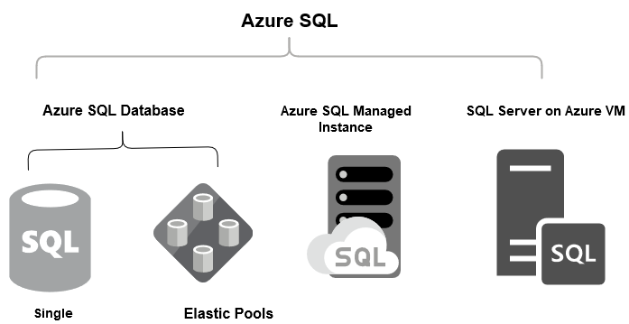
Azure Storage
Implementing SQL databases
Source: https://www.sqlshack.com/provisioning-azure-sql-database-using-azure-powershell/

Slide 44
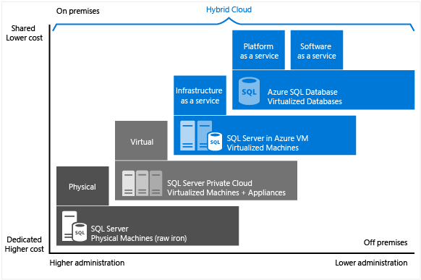
Azure Storage
Implementing SQL databases
In the below Microsoft docs image, we get a comparison for the costs and administration tasks of on-premises and cloud databases.
Source: https://www.sqlshack.com/provisioning-azure-sql-database-using-azure-powershell/

Slide 45
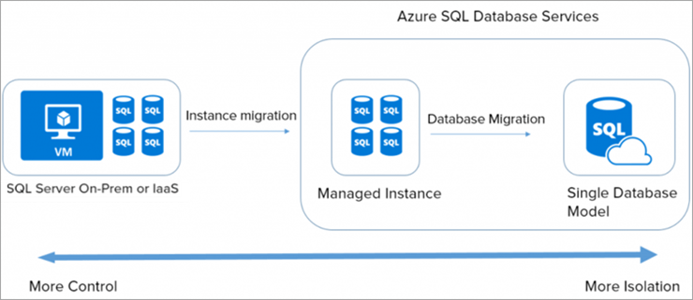
Azure Storage
Implementing SQL databases
Steps to maintain a single database using Microsoft Azure Cloud:
For this, we will require Azure Portal using these below scripts:
PowerShell script
Azure CLI script
A single database is the most manageable and most responsive option for Azure SQL Database. We can also raise the query to the database using the Query editor in the Azure portal. A single database is an advanced cloud application and maintained by microservices and reliable data sources.
Source: https://www.softwaretestinghelp.com/microsoft-azure-sql-database-tutorial/

Slide 46
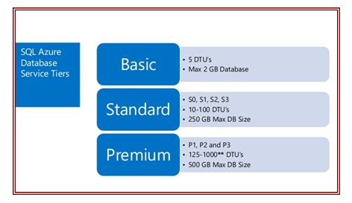
Azure Storage
Choosing a service tier
The database size, performance level, disaster recovery capabilities, and price of each of Azure's service tiers vary. Every day, subscribers are charged based on how many databases they used. Based on the highest service tier and performance level employed that day, the price per database is determined. An SLA of 99.95% uptime is included with each of the three new service tiers.
Source: https://blog.sysfore.com/azure-sql-databases-service-tiers-and-performance-options/

Slide 47
Azure Storage
Choosing a service tier
Basic Tier
Tiny workloads and relatively small data volumes are catered to at the entry level tier. designed with modest transactional workloads and continuity requirements in mind.
An expected hourly transaction rate is provided by the Basic performance targets. The Basic Tier database can be up to 2 GB in size.
Examples include programmes that are only sometimes utilised or databases used for tiny test and development projects.

Slide 48
Azure Storage
Choosing a service tier
Standard Tier
The Standard edition is on the intermediate level. For cloud-based applications that require greater space and performance than the Basic tier can offer, it offers database support.
It provides characteristics for business continuity and performance at a mid-level. The Standard performance goals offer predictable per-minute transaction rates. Standard databases can only be up to 250 GB in capacity.
Workgroup databases and web applications are two examples.

Slide 49
Azure Storage
Choosing a service tier
Premium Tier
It is intended for use with mission-critical databases that demand high performance levels and sophisticated business continuity and disaster recovery features.
The best performance and access levels are available with premium. The Premium Performance Objectives offer reliable transaction rates per second. A Premium database can only be 500 GB in capacity.
Examples include databases that must provide the greatest level of business continuity capabilities and serve mission-critical applications with significant transactional volume.

Slide 50
Azure Storage
Implementing point-in-time recovery
A database can be restored to the condition it was in at any given time using point-in-time recovery. Only databases that use the complete or bulk-logged recovery model can use this form of recovery.
Recovery to a specific point in time is not possible if the database uses the bulk-logged recovery paradigm and the transaction log backup contains bulk-logged modifications.
Let's examine the use case with a sample database (under the full recovery model), where a full backup is generated every 24 hours, a differential database backup is created every 6 hours, and transaction log backups are created every hour, in order to understand how point-in-time recovery functions.

Slide 51
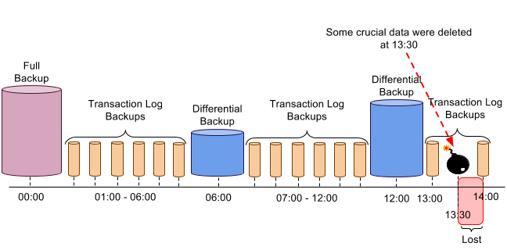
Azure Storage
Implementing point-in-time recovery
Source :https://academy.sqlbak.com/point-in-time-recovery/

Slide 52
Azure Storage
Implementing geo-replication
A feature called active geo-replication allows you to build a continually synchronised, readable secondary database for a primary database.
The viewable secondary database may be in a separate Azure region than the primary database, but this is more typical. Other names for these readable secondary databases are geo-secondaries and geo-replicas.
As a business continuity solution, active geo-replication enables you to quickly recover individual databases in the event of a local catastrophe or widespread outage.
You can start a geo-failover to a geo-secondary in a separate Azure region once geo-replication has been configured. The application programmatically starts the geo-failover, or the user can start it manually.

Slide 53
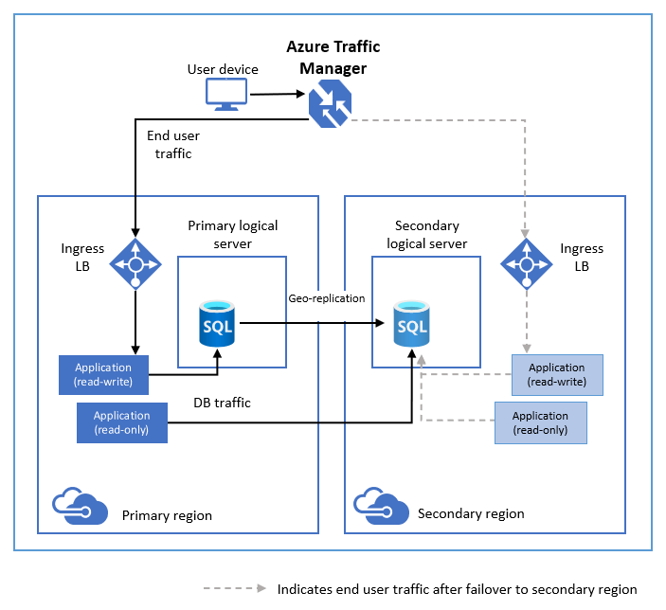
Azure Storage
Implementing geo-replication
The following diagram illustrates a typical configuration of a geo-redundant cloud application using Active geo-replication.
Source: https://docs.microsoft.com/en-us/azure/azure-sql/database/active-geo-replication-overview?view=azuresql

Slide 54
Azure Storage
Implementing geo-replication
Create secondary replicas in the same area as the primary using geo-replication.
These secondaries can be used to fulfil read scale-out scenarios in the same area.
For disaster recovery purposes, a backup copy in the same region is not a suitable failover target because it does not give additional resilience to catastrophic failures or large-scale outages.
Additionally, it doesn't ensure availability zone separation.
To achieve availability zone isolation, use General Purpose service tier zone redundant configuration, Business Critical or Premium service tier zone redundant configuration, or both.

Slide 55
Azure Storage
Scalability strategies
As much as your budget will allow, you can scale up and out in ways that you couldn't with your own hardware. But more crucially, you can scale up or down to save money when you don't need the resources. If you acquired a lot of servers to handle your peak load, you wouldn't be able to do this.
Scale in, out, up, and down.
Basically, there are two primary approaches to resource scaling:
scaling up and down in the vertical
Vertical: Scaling in and out

Slide 56
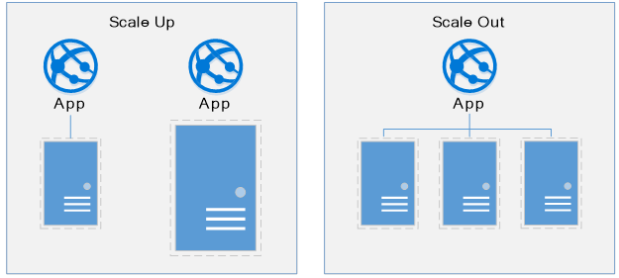
Azure Storage
Scalability strategies
https://www.azurebarry.com/how-to-autoscale-azure-app-services-cloud-services/

Slide 57
Azure Storage
Scalability strategies
Design for scalability
The cloud thrives on scaling. The ability to increase/decrease system resources to address increasing/decreasing system load is a key tenet of the Azure cloud. But, to effectively scale an application, you need an understanding of the scaling features of each Azure service that you include in your application. Here are recommendations for effectively implementing scaling in your system.

Slide 58
Azure Storage
Scalability strategies
Design for scaling. An application must be designed for scaling. To start, services should be stateless so that requests can be routed to any instance.
Having stateless services also means that adding or removing an instance doesn't adversely impact current users.
Partition workloads. Decomposing domains into independent, self-contained microservices enable each service to scale independently of others.
Typically, services will have different scalability needs and requirements. Partitioning enables you to scale only what needs to be scaled without the unnecessary cost of scaling an entire application

Slide 59
Azure Storage
Importing and exporting data
By sending disk drives to an Azure datacenter, vast amounts of data may be safely imported to Azure Files and Azure Blob storage.
Additionally, you can use this service to move data from Azure Blob storage to hard drives and deliver it to your on-premises facilities.
we can import data from one or more hard drives into Azure Files or Azure Blob storage.

Slide 60
Azure Storage
Importing and exporting data
Azure Import/Export use cases
Consider using Azure Import/Export service when uploading or downloading data over the network is too slow, or getting additional network bandwidth is cost-prohibitive. Use this service in the following scenarios:
Data migration to the cloud: Move large amounts of data to Azure quickly and cost effectively.
Content distribution: Quickly send data to your customer sites.
Backup: Take backups of your on-premises data to store in Azure Storage.
Data recovery: Recover large amount of data stored in storage and have it delivered to your on-premises location.

Slide 61
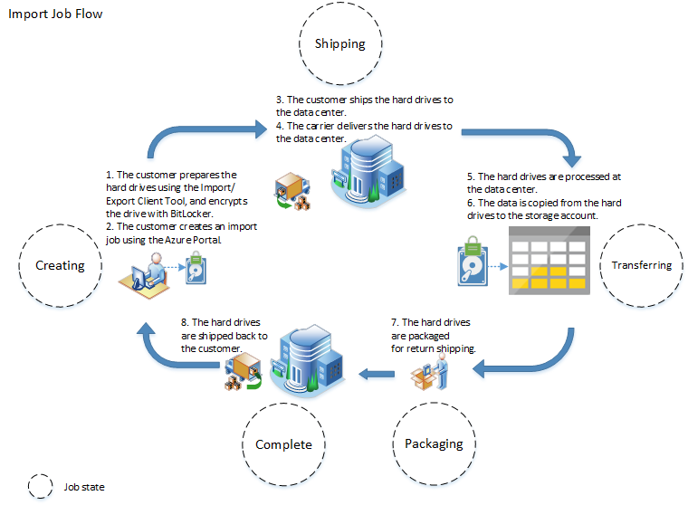
Azure Storage
Importing and exporting data
Source: https://docs.microsoft.com/en-us/azure/import-export/storage-import-export-service

Slide 62

Azure Storage
Summary
In this module, we have studied Azure Storage, The foundation of the Microsoft Azure virtual machine system is Page Blobs. They were created expressly with disc space constraints in mind; each Page Blob should be larger than 512 bytes.
An Azure Key Vault admin grants permissions to encryption keys to a managed identity. The managed identity may be either a user-assigned managed identity that you create and manage, or a system-assigned managed identity that is associated with the storage account.
A feature called active geo-replication allows you to build a continually synchronized, readable secondary database for a primary database. The viewable secondary database may be in a separate Azure region than the primary database, but this is more typical. Other names for these readable secondary databases are geo-secondaries and geo-replicas.

Slide 63
Azure Storage
Self Assessment ( Quiz)
Q1. Which one of the following is not correct regarding Azure storage?
A. Data's are highly available.
B. Storing datas in Azure Storage is secured.
C. No redundant data
D. None of these.
Answer: C

Slide 64
Azure Storage
Q2. Which one of the following is the data service provided by Azure Storage platform?
A. Azure Blobs
B. Azure Tables
C. Azure Queues
D. All of these.
Answer: D

Slide 65
Azure Storage
Q3. Which one of the following provides block level storage volumes for Azure VMs?
A. Azure Disks
B. Azure Blobs
C. Azure Queues
D. Azure Tables
Answer: A

Slide 66
Azure Storage
Q4. Which one of the following is most preferred for storing streaming videos and audios?
A. Azure Files
B. Azure Queues
C. Azure Blobs
D. Azure Tables
Answer: C

Slide 67
Azure Storage
Q5. How many replication options are there while creating an Azure storage account?
A. 2
B. 5
C. 8
D. 4
Answer: D

Slide 68
Azure Storage
Q6. While creating Azure Storage account, which replication option is the cheapest one?
A. Zone redundant storage
B. Locally redundant storage
C. Geo redundant storage
D. Read access geo redundant storage
Answer: B

Slide 69
Azure Storage
Q7. How many copies of data are created in case of geo redundant storage replication?
A. 6
B. 2
C. 3
D. 4
Answer-A

Slide 70
Azure Storage
Q8. Choose the incorrect option regarding Zone redundant storage replication.
A. It can be used for blobs only
B. 3 copies of data are created.
C. Copies of data must be created in the facilities of same region.
D. None of these
Answer: C

Slide 71
Azure Storage
Q9. What can be the maximum size of a queue message?
A. 256 KB
B. 64 KB
C. 128 KB
D. No maximum size is there.
Answer: B

Slide 72
Azure Storage
10. Choose the correct option regarding Azure Storage.
A. It is possible to have role based access control for Blob and Queue storage service of Azure.
B. Shared key authorization is also possible.
C. It is possible to specify a container and its blob public.
D. All of these.
Answer: D

Slide 73

Azure Storage
Activity
Activity Type: Offline Duration: 60 Minutes
Description: Case study
An environmental engineering company with 2,500 employees spread across 80 offices faced two major problems:
Constantly running out of local disk space on their on-premises file servers
The looming threat of natural disasters, fires, and power outages Either of these situations could cause sudden server outages, resulting in a productivity and business cost to their bottom line. By adopting Azure Files along with Azure File Sync, they were able to improve server recovery times to nearly instantaneous and give their employees the ability to work without interruptions.

Slide 74

Azure Storage
Subjective Assessment
Explain the need of Azure Storage account ?
What are the Objective of Blob Storage ?
Discuss the limitation of Import and export of Data in Azure platform.

Slide 75

Azure Storage
External Resources
Learning Microsoft Azure Storage by Mohamed Waly Released November 2017 Publisher(s): Packt Publishing ISBN: 9781785884917
https://www.manning.com/books/azure-storage-streaming-and-batch-analytics

Slide 76
Azure Storage
Document Links
Topics | URL | Notes
Azure Storage | https://download.microsoft.com/download/6/6/2/662DD05E-BAD7-46EF-9431-135F9BAE6332/9781509302963_Microsoft%20Azure%20Essentials%20Fundamentals%20of%20Azure%202nd%20ed%20pdf.pdf | This link explain Azure Storage
Azure Import/Export | https://docs.microsoft.com/en-us/azure/import-export/storage-import-export-service | This link explains Azure Import/Export

Slide 77
Azure Storage
Video Links
Topics | URL | Notes
Blob | https://www.youtube.com/watch?v=dgGV2HlVE9E | This video explains Blob
Azure Files | https://www.youtube.com/watch?v=Vm5QXbRPoKI | You will learn Azure Files
Azure SQL | https://www.youtube.com/watch?v=8ulro2MPiYs | This video explains Azure SQL

Slide 78
Azure Storage
E-Book Links
Topics | URL | Page Number
Azure Storage | · https://download.microsoft.com/download/6/6/2/662DD05E-BAD7-46EF-9431-135F9BAE6332/9781509302963_Microsoft%20Azure%20Essentials%20Fundamentals%20of%20Azure%202nd%20ed%20pdf.pdf | All pages

